Slide 1
UIT2201 – Programming and Data Structures
Abstract Collection Types in Python

Slide 2
Collections Types
Python provides high-level abstract collections such as list, tuple, str, etc.
These collections are basically linear structures that are iterable
An iterator is an object that manages an iteration through a series of values. If i is an iterator, then “next(i)” produces the next element in the series “StopIteration” exeception is raised when there is no more element in the series
An iterable is an object “obj” that can produce an iterator via the syntax “iter(obj)”

Slide 3
Iterable
A Python object which can be looped over or iterated over in a loop.
Popular built-in Python data structures such as lists, tuples, and sets qualify as iterables.
Other data structures like strings and dictionaries are also considered iterables: a string can produce iteration of its characters, and the keys of a dictionary can be iterated upon.
As a rule of thumb, consider any object that can be iterated over in a for-loop as an iterable.

Slide 4
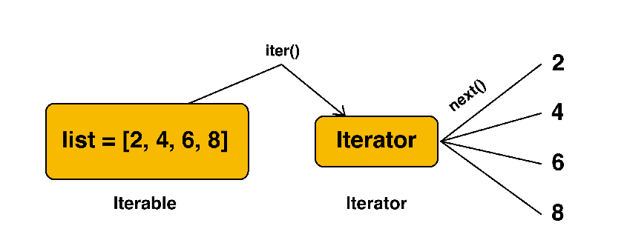
Iterators
An iterator is an object that can be iterated upon. Thus, iterators contain a countable number of values.
Iterators in Python are used to iterate through a sequence without knowing the index value of the elements.

Slide 5
Iterator
The iterator object is initialized using the iter() method. It uses the next() method for iteration.
__iter__(): The iter() method is called for the initialization of an iterator. This returns an iterator object
__next__(): The next method returns the next value for the iterable.
When we use a for loop to traverse any iterable object, internally it uses the iter() method to get an iterator object, which further uses the next() method to iterate over. This method raises a StopIteration to signal the end of the iteration.

Slide 6
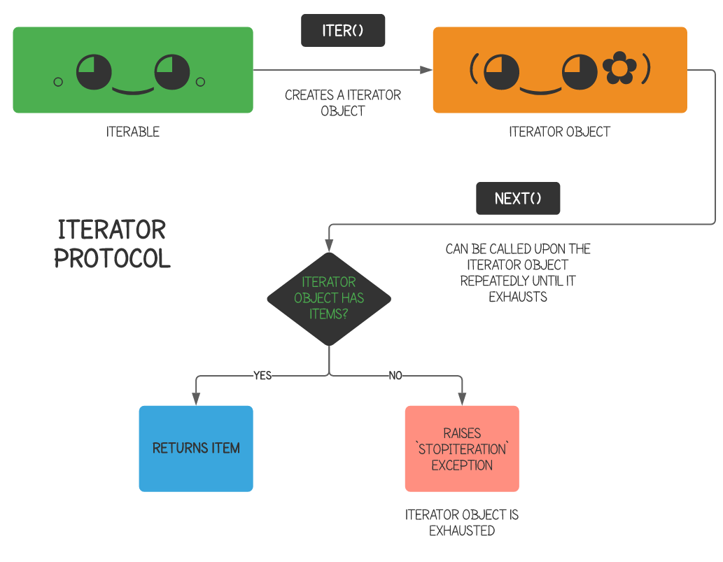
Iterator

Slide 7
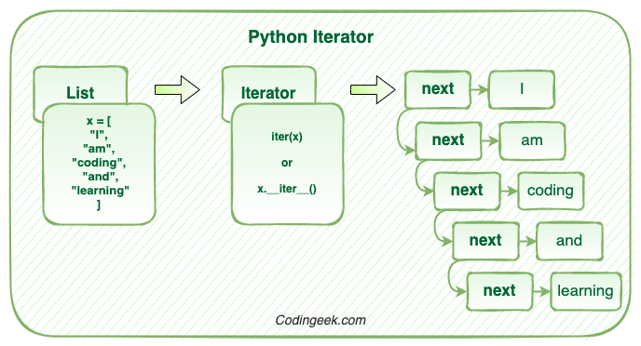
Iterator

Slide 8
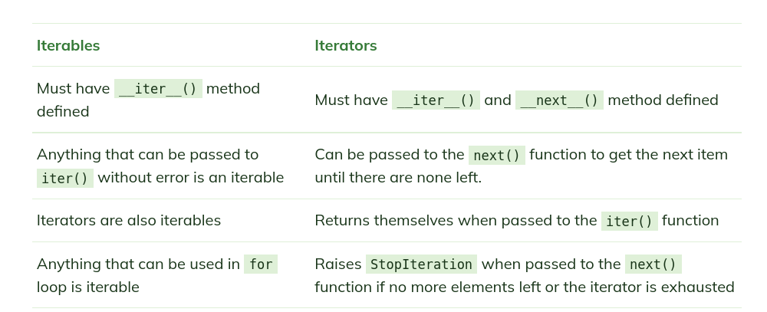
Difference between Iterable and Iterator

Slide 9
Advantage of iterator
Iterators allow lazy evaluation, only generating the next element of an iterable object when requested. This is useful for very large data sets.
Lazy evaluation is a strategy whereby certain objects are only produced when required. Consequently, certain developer circles also refer to lazy evaluation as “call-by-need”

Slide 10
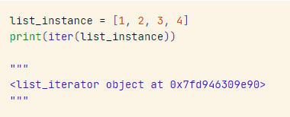
Iterator object
Instantiate a list, which is an iterable, and produce an iterator by calling the iter() built-in function on the list. Although the list by itself is not an iterator, calling the iter() function converts it to an iterator and returns the iterator object.

Slide 11
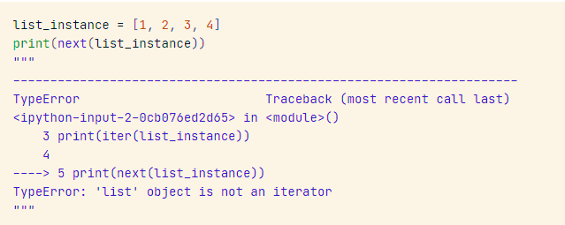
next() on iterable
To demonstrate that not all iterables are iterators, we will instantiate the same list object and attempt to call the next() function, which is used to return the next item in an iterator.

Slide 12
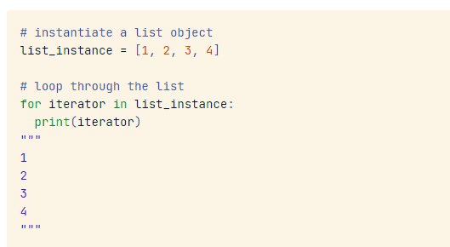
Iterable using for loop
Python automatically produces an iterator object whenever you attempt to loop through an iterable object.
When the StopIteration exception is caught, then the loop ends.
The values obtained from an iterator can only be retrieved from left to right. Python does not have a previous() function to enable developers to move backward through an iterator.

Slide 13
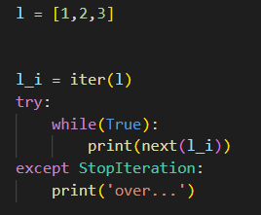
next() on Iterator
Iterators have a lazy nature: when an iterator is created, the elements are not yielded until they are requested.
In other words, the elements of our list instance would only be returned once we explicitly ask them to be with next(iter(list_instance)).

Slide 14
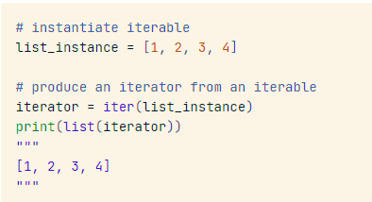
Iterable container on iterator object
However, all of the values from an iterator may be extracted at once by calling a built-in iterable data structure container (i.e., list(), set(), tuple()) on the iterator object to force the iterator to generate all its elements at once.
It’s not recommended to perform this action, especially when the elements the iterator returns are large since this will take a long time to process.

Slide 15
Iterable Objects
Python provides an automatic iterator for any collection type that defines “__len__” and “__getitem__” methods
In this course, we will be discussing linear and non-linear data structures, and most of them will be Iterable

Slide 16
Vector ADT
We will now design a n-dimensional Vector class as a collection type We will explicitly store the dimension n, and a sequence of n coordinate values
It is natural to think of a constructor that initializes a vector from a sequence of n values

Slide 17
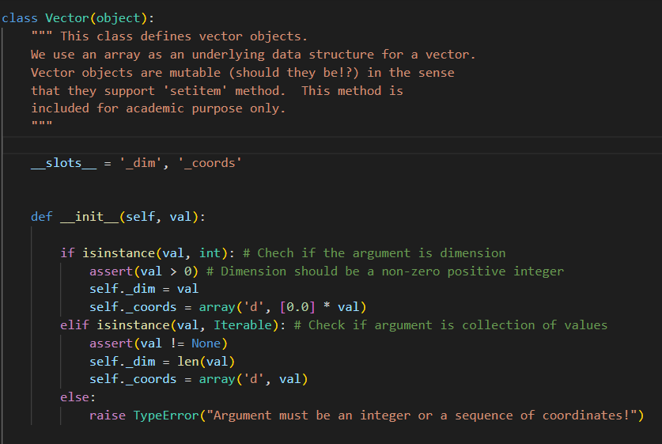
Vector ADT

Slide 18
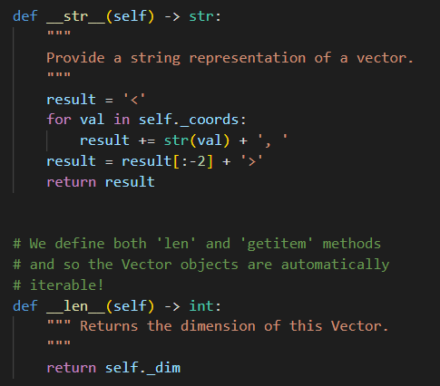
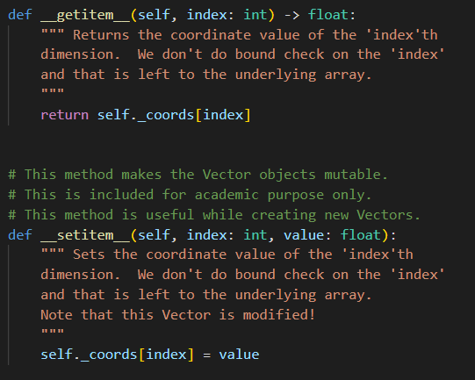
Vector ADT

Slide 19
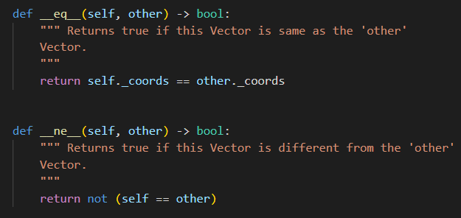
Vector ADT

Slide 20
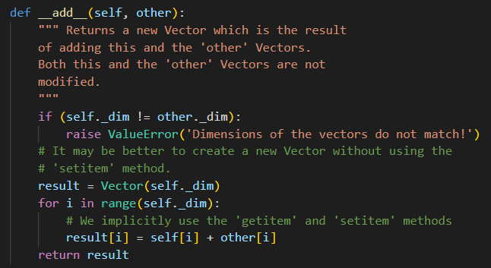
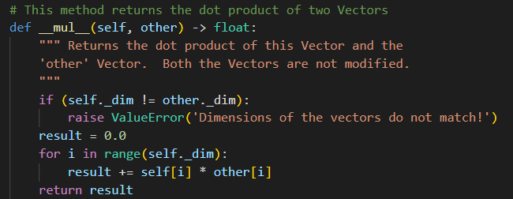
Vector ADT

Slide 21
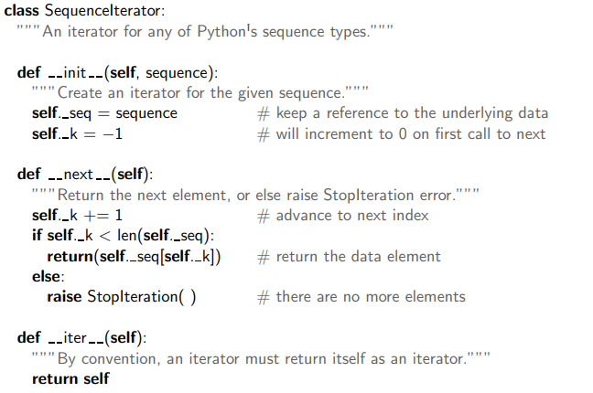
Sequence Iterator

Slide 22
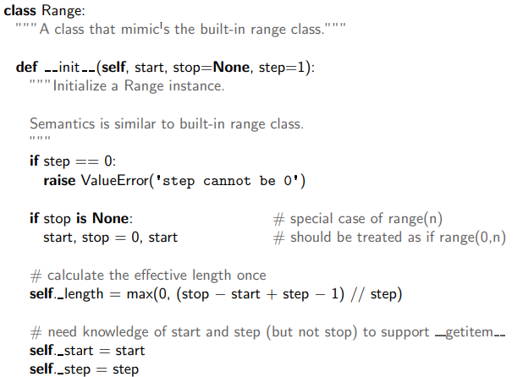
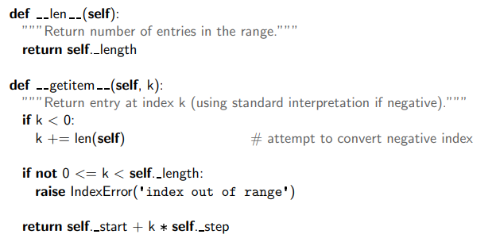
Range class

Slide 23
Python Generators
The most expedient alternative to implementing an iterator is to use a generator.
Although generators may look like ordinary Python functions, they are different.
For starters, a generator object does not return items. Instead, it uses the yield keyword to generate items on the fly.
Thus, we can say a generator is a special kind of function that leverages lazy evaluation.
Generators do not store their contents in memory as you would expect a typical iterable to do.

Slide 24
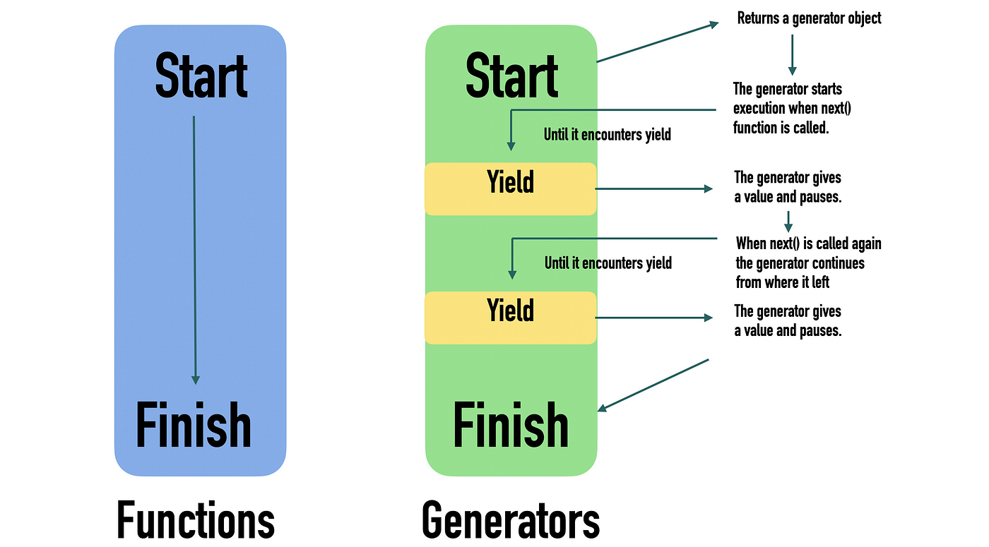
Generators

Slide 25
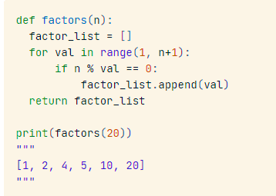
Traditional user defined function for generating factors
For example, if the goal were to find all of the factors for a positive integer, we would typically implement a traditional function as follows:
The code above returns the entire list of factors.

Slide 26
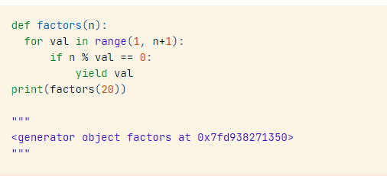
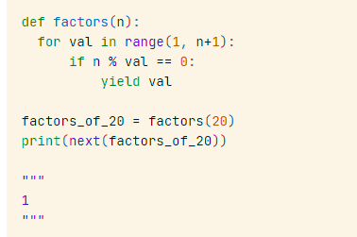
Generator object
Since we used the yield keyword instead of return, the function is not exited after the run. In essence, we told Python to create a generator object instead of a traditional function, which enables the state of the generator object to be tracked.
Consequently, it is possible to call the next() function on the lazy iterator to show the elements of the series one at a time.

